Slide 1
Data Structures
9. List ADT

Slide 2
Roadmap
List as an ADT
An array-based implementation of lists
Introduction to linked lists
A pointer-based implementation in C++
Variations of linked lists

Slide 3
Examples of Everyday List
Everyday usage of the term “list” refers to a linear collection of data items
Groceries to be purchased
Ingredients of a recipe
Job to-do list
List of assignments for a course
List of courses for summer semester
Can you name some others??

Slide 4
List (1)
A collection of items of the same type
A flexible structure that can grow and shrink on demand
Elements can be:
Inserted
Accessed
Deleted
at any position!

Slide 5
List (2)
A list is a sequence of zero or more elements of a given type
Represented by a comma-separated sequence of elements
Where n ≥ 0 and each a_{i} is of type element_type
Number of elements n determines the length of the list
If n ≥ 1
a₁ is the first element
a_{n} is the last element
If n = 0
List has no elements (empty list)
a₁, a₂, a₃, . . . ., a_{n}

Slide 6
List (3)
Elements of a list can be linearly ordered according to their position
a_{i} precedes a_{i+1} for i = 1,2,3…n-1
a_{i} follows a_{i-1} for i = 2,3,4…n
Element a_{i} is at position i

Slide 7
Properties of Lists
Can have a single element
Can have no elements
Can be list of lists
Can be concatenated together
Can be split into sub-lists

Slide 8
List as an ADT
We will look at the list as an abstract data type
Homogeneous
Finite length ??
Sequential elements
Is this information sufficient for defining ADT?

Slide 9
Basic Operations (1)
Create the list
The list is initialized to an empty state
Determine whether the list is empty
Determine whether the list is full
Find the size of the list
Destroy, or clear, the list
Insert an item in the list at the specified location
Delete an item from the list at the specified location
Replace an item at the specified location with another item
Retrieve an item from the list at the specified location
Search the list for a given item
Traverse (iterate through) the elements of the list

Slide 10
Basic Operations (2)
INSERT(x, p, L)
Insert x at position p in list L
If list L has no position p, the result is undefined
RETRIEVE(p, L)
Return the element at position p on list L
LOCATE(x, L)
Return the position of x on list L
DELETE(p, L)
Delete the element at position p on list L

Slide 11
Basic Operations (3)
MAKENULL(L)
Causes L to become an empty list and returns position END(L)
NEXT(p, L)
Return the position following p on list L
PREVIOUS(p,L)
Return the position preceding position p on list L
FIRST(L)
Returns the first position on the list L

Slide 12
Basic Operations (4)
PRINTLIST(L)
Print the elements of L in order of occurrence
And more …

Slide 13
List as a Data Structure (1)
We know the ADT of the list, how to implement it?
Create a List class, containing at least the following function members
Constructor
isEmpty()
insert()
delete()
print()
What are the other function members?
isFull(), listSize(), retrieve(), replace(), search(), clearList( ), …

Slide 14
List as a Data Structure (2)
Implementation involves
Defining data members
Defining function members from design phase
In terms of implementation, there are two possible approaches
Array-based implementation of list
Pointers-based implementation of list (called Linked List)

Slide 15
Array-Based Implementation of Lists

Slide 16
Array-Based Implementation
An array is a viable choice for storing list elements
Elements are sequential
Array is a commonly available data type
Algorithm development is easy
Normally sequential orderings of list elements match with array indices
List
a₁
a₂
a₃
a_{n}
Array
….
….
a[0]
a[1]
a[2]
a[n-1]
a[SIZE -1]

Slide 17
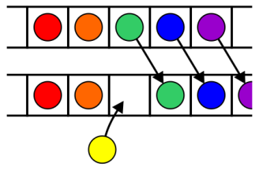
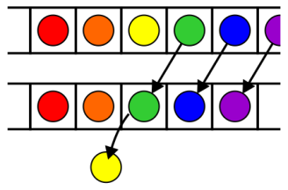
Implementing Operations
Constructor
Static array allocated at compile time
isEmpty
Check if size == 0
traverse/ print
Use a loop from 0th element to size – 1
insert
Shift elements to right of insertion point
delete
Shift elements back
Insertion of a new object
Removal of an object

Slide 18
Inefficiency of Array-Based Implementation
insert(), delete() functions inefficient for dynamic lists
Frequent changes
Many insertions and deletions
So …
We look for an alternative implementation

Slide 19
An Alternative Implementation
1
3
4
10
How to insert and delete?
Need a start link?
I data[I] next[I]
0 3 6
1 * *
2 1 0
3 10 -1
4 * *
5 * *
6 4 3
Start
End

Slide 20
Yet Another Implementation – Free List (1)
Free List
1
3
4
10
I data[I] next[I]
0 3 6
1 * 4
2 1 0
3 10 -1
4 * -1
5 * 1
6 4 3
Data Start
Free Start
End

Slide 21
Yet Another Implementation – Free List (2)
I data[I] next[I]
0 * 6
1 * 4
2 * 0
3 * 5
4 * -1
5 * 1
6 * 3
Free Start
End

Slide 22
List Class with Static Arrays - Problems
Stuck with "one size fits all"
Could be wasting space
Could run out of space
Better to have instantiation of a list by specifying the capacity (i.e., size)
Consider creating a List class with dynamically-allocated array

Slide 23
Dynamic Allocation of List Class (1)
Changes required in data members
Eliminate constant declaration for CAPACITY/SIZE
Data member to store capacity specified by client program
Little or no changes required for many function members
isEmpty()
display()
delete()
insert()

Slide 24
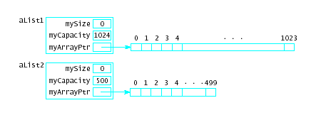
Dynamic Allocation of List Class (2)
Now possible to specify different sized lists
cin >> maxListSize; List aList1 (maxListSize); List aList2 (500);

Slide 25
Implementation of List Class
Problem 1: Array used has fixed capacity
If larger array needed during program execution
Allocate, copy smaller array to the new one
Problem 2: Class bound to one type at a time
Create multiple List classes with differing names
Use class template

Slide 26
Any Question So Far?

